Slide 1
The Opioid Crisis
What Early Care and Education Providers Need to Know

Slide 2
Outline
Overview of opioids and the opioids crisis
Presenter: Stephanie Schmitz Bechteler, PhD, Chicago Urban League
Implications for young children and their families
Presenter: Carie Bires, Ounce of Prevention Fund
Addressing the crisis
Presenter: Julia Zhu, Governor’s Office of Early Childhood Development
Program response
Presenter: Brent Cummins, Chestnut Health Systems
Closing

Slide 3
Understanding Opioids and Opioid Use in Illinois
Stephanie Schmitz Bechteler, PhD.
Vice President and Executive Director,
Research & Policy Center at the Chicago Urban League

Slide 4
What are opioids?
Opioids are a class of drugs that are used to reduce or dull pain
Can be used/misused medically for physical pain (acute pain; chronic pain)
Misused medically for emotional pain (depression, anxiety, trauma)
A substance classified into three forms: NATURAL, SEMI- SYNTHETIC and SYNTHETIC
Opiate – this is what people call the “natural form”
A chemical compound that occurs naturally in plants like the poppy which can be extracted to make morphine
Semi-Synthetic Opioid – created/derived in a lab from natural opiates, which can be used to make hydrocodone (Vicodin), oxycodone (OxyContin) and heroin
Synthetic Opioid – completely manmade lab substances which can be used to make fentanyl

Slide 5
Which opioids are often discussed?
Opioid pills (Commonly referred to as “pain pills” – Vicodin, OxyContin, Percocet, Dilaudid)
Use: Medical or nonmedical pain management
Access: Prescribed by a licensed physician or diversion (family, friends, drug market sales)
Administration: oral/IV for medical pain management; oral, nasal, injection for nonmedical pain management
Heroin
Use: nonmedical pain management
Access: drug market sales
Administration: nasal, injection, inhalation
Fentanyl
Use: Medical or nonmedical pain management
Access: Prescribed by a licensed physician or increasingly added to heroin for use in drug market sales
Administration: oral/patch/IV for medical pain management; however heroin is administered

Slide 6
How did the U.S. get here – why all the opioid use?
Setting The Stage: The late 1990s and early 2000s
Prescription Opioid Use
Pharmaceutical Marketing
Increasingly advertised as an effective means of pain management for people with chronic pain
Pharmaceutical companies assured healthcare providers their specialized time-released formulations would not result in dependency and would be safe for non-cancer pain management
Physician Practices
Concerns about the pattern and practice of undertreating pain and causing undue suffering to patients lead to increased awareness of pain as a treatable condition
Heroin Use
Product Changes
Heroin purity significantly increased after years of poor quality product
Heroin became more refined and available in a snortable powder format
Availability
Southeast Asian, Southwest Asian and South American suppliers brought their product to the States, increasing availability beyond what had been supplied by Mexico
Price decreased, making it more affordable ($10 dime bag)

Slide 7
How did the U.S. get here – why all the opioid use?
The Start of an Epidemic: Mid-2000 to 2010s
Prescription Opioid Use
Opioid medications were prescribed at increased rates – OxyContin prescriptions alone rose from 607,000 patients in 1997 to 6.2 million in 2002
Prescribing rates rose dramatically in nearly every state in the nation starting in 2006 and peaking in 2012
215.9 million prescriptions in 2006 (72 prescriptions per 100 persons)
255.2 million prescriptions in 2012 (81.3 prescriptions per 100 persons)
Heroin Use
Heroin use began slowly increasing nationwide between 2002-2006, then rose rapidly in the late-2000s
Initiations to heroin use varied by age group, with younger users driving much of the increase
Age 18-25: 66,000 in 2002 to 100,000 in 2011
Age 26+: 12,000 in 2002 to 82,000 in 2011
All ages: 117,000 in 2002 to 178,000 in 2011
The total number of people using heroin nationwide rose from 404,000 in 2002 to 681,000 in 2013

Slide 8
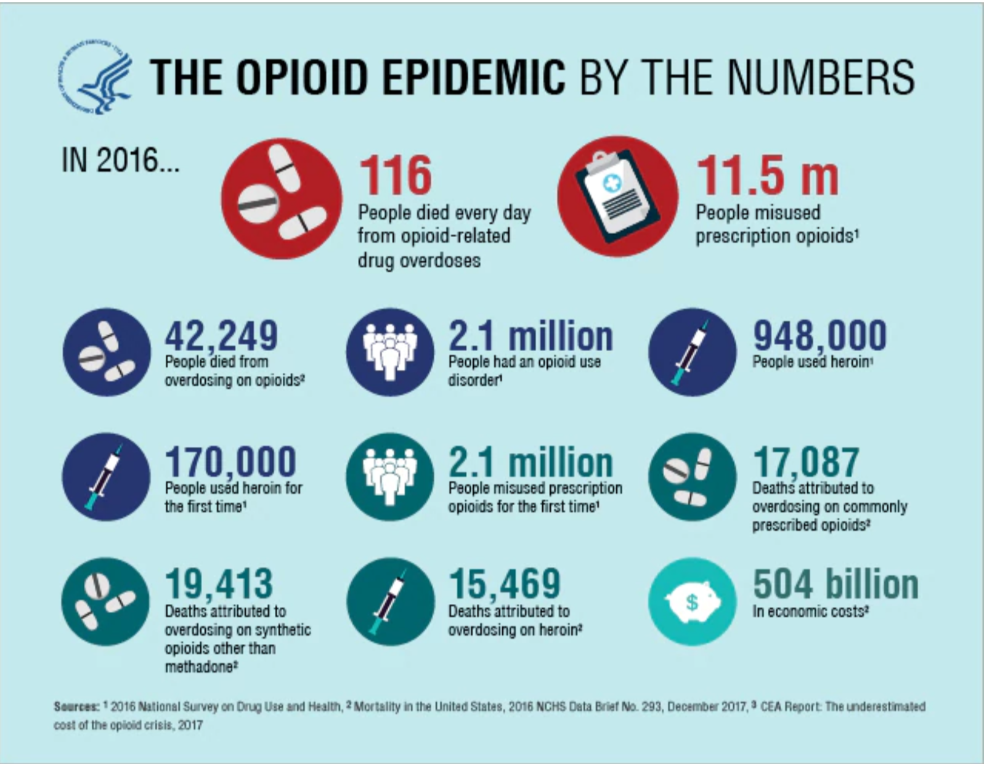
How did the U.S. get here – why all the opioid use?

Slide 9
What does opioid use look like in Illinois?
What is the scope of the problem?
An estimated 180,000 Illinoisans have a diagnosable opioid use disorder
Approximately 19,300 DASA-funded treatment admissions in 2015 were for opioids
16,303 (84.5%) reported heroin as their primary substance (nearly tied alcohol as primary reason for treatment)
2,946 (15.3%) reported other opioids as their primary substance
Heroin Use in Illinois – Who is using heroin?
Age, Race and Place
In Chicago, the majority of people aged 30 and younger using heroin were white (approx. 55%); the majority of people aged 30 and older are African American (approx. 85%)
In Suburban Cook Co, the majority of people aged 40 and younger using heroin were white (approx. 75%); the majority of people aged 40 and older are African American (approx. 54%)
In the Collar Counties, the majority of people using heroin were white for all age groupings (approx. 70% for all age groupings)
In the Rest of Illinois, patterns of heroin initiation and use are similar to patterns observed in the Collar Counties – throughout the state, initiation and use increased among young, White people

Slide 10
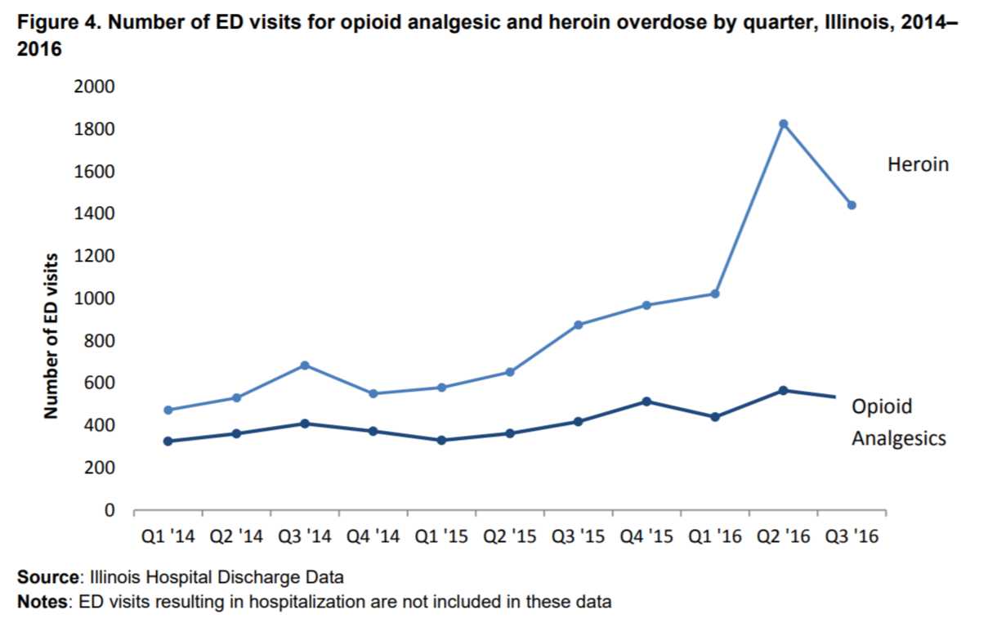
How has opioid use impacted Illinois?
ED Visits for Opioids

Slide 11
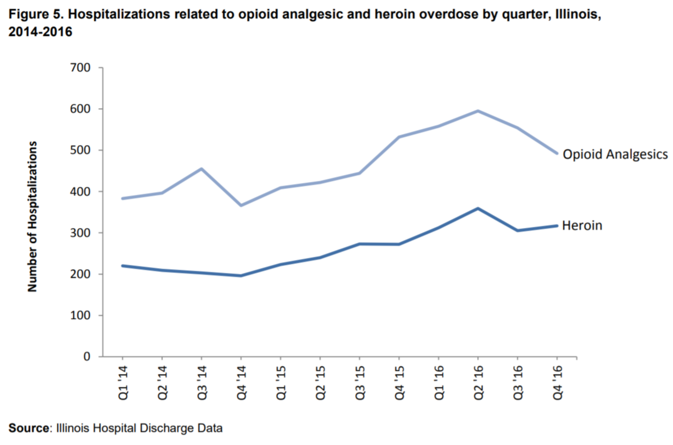
How has opioid use impacted Illinois?
Hospitalizations for Opioids

Slide 12
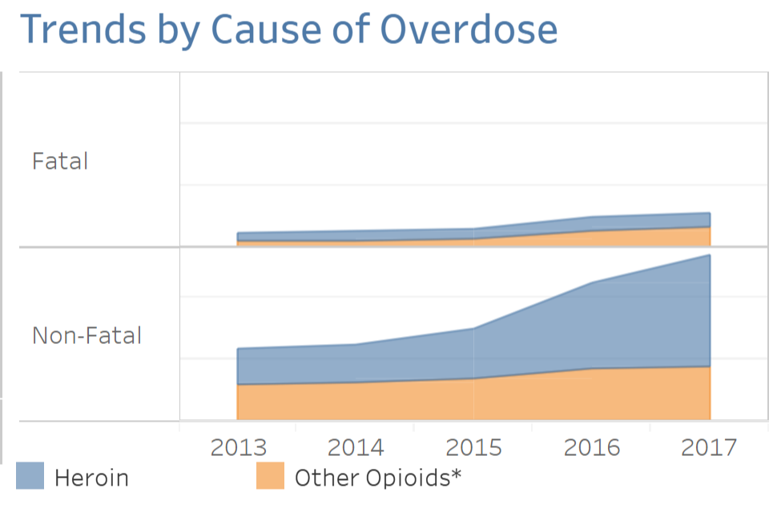
How has opioid use impacted Illinois?
Non-Fatal and Fatal Overdose (https://idph.illinois.gov/OpioidDataDashboard/)
Cause of Overdose

Slide 13
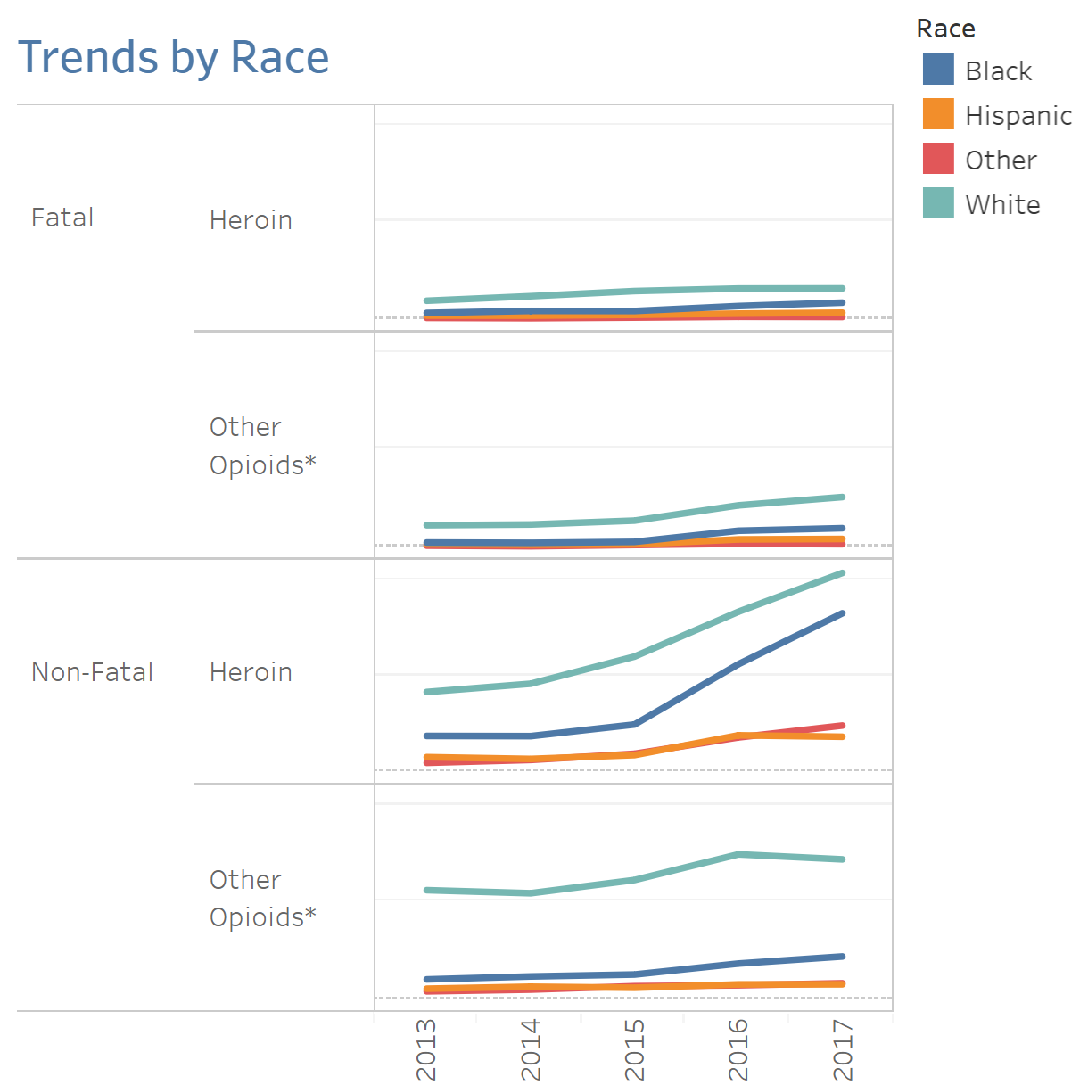
How has opioid use impacted Illinois?
Non-Fatal and Fatal Overdose (https://idph.illinois.gov/OpioidDataDashboard/)
Trends by Race

Slide 14
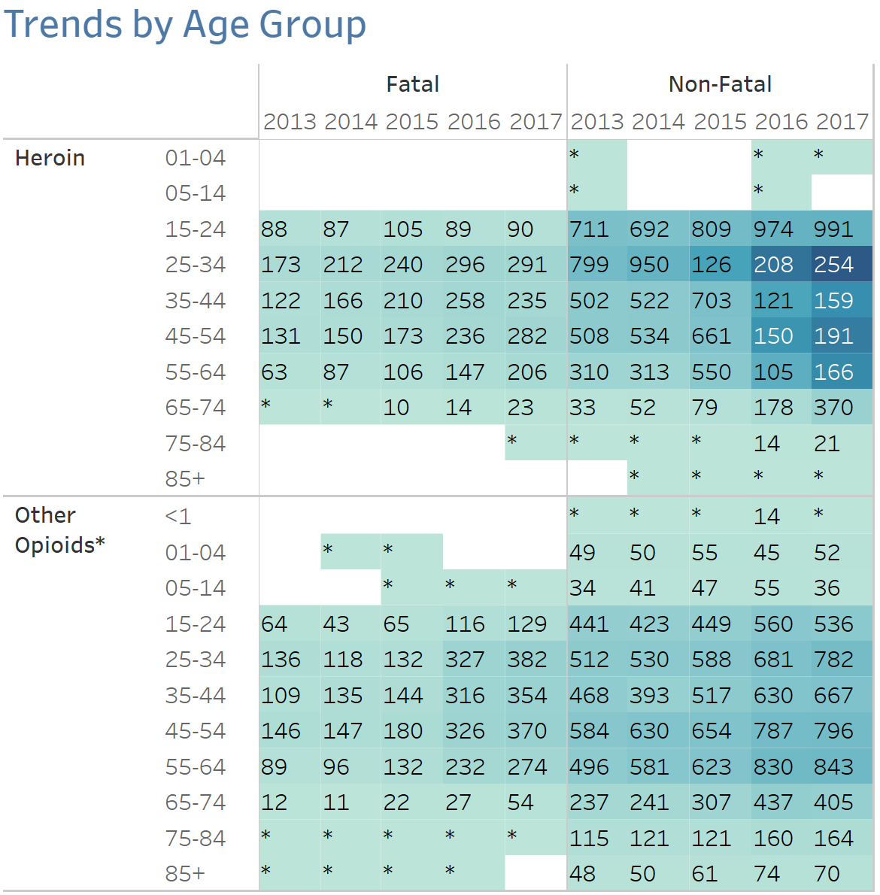
How has opioid use impacted Illinois?
Non-Fatal and Fatal Overdose (https://idph.illinois.gov/OpioidDataDashboard/)
Trends by Age

Slide 15
What are the impacts on the person and their family?
Opioid Career
Dependence and Use Disorders
Neonatal Abstinence Syndrome (NAS)
Treatment
Incarceration
HIV/HCV and other health risks
Morbidity & Mortality

Slide 16
What are the impacts on communities and what responses are needed?
Communities (geographic, demographic) need to target policies, programs and services in the following areas:
Treatment Capacity
Overdose education and prevention services
HIV/HCV education and prevention services
First responder education and training
Expansion of naloxone distribution
Pain alternatives

Slide 17
The Opioid Crisis: What Early Care and Education Providers Need to Know
June 11, 2018
Implications for children and families

Slide 18
Risks to physical and social-emotional well-being
Neonatal Abstinence Syndrome (NAS)
Accidental overdose or ingestion
Trauma related to observing overdose, arrest, etc.
Risk of maltreatment and subsequent child welfare involvement

Slide 19
Lack of resources and supports hamper our response
Lack of treatment resources
Geographic disparities
MAT for pregnant women
Accommodating parents with children
Lack of child care, dedicated early childhood resources
Lack of supports for kinship caregivers
Not enough accurate and detailed data
Best practices still emerging

Slide 20
Other concerns
Lack of comprehensive, consistent, and aligned policy, procedure, and practice
Response efforts have focused mostly on adults, not children or families as a unit
Lack of attention on prevention, particularly secondary prevention
Low awareness
Stigma

Slide 21
Addressing the Crisis
The Opioid Crisis: What Early Care and Education Providers Need to Know

Slide 22
Federal Response-Department of Health and Human Services
Five point strategy to combat the opioid crisis
Access: better addiction prevention, treatment, and recovery services
Data: Better data on the epidemic
Pain: Better pain management
Overdoses: Better targeting of overdose reversing drugs
Research: Better research on pain and addiction

Slide 23
State Response
State of Illinois Opioid Action Plan and State Targeted Response
Prevention: preventing people from using opioids
Treatment and Recovery: providing evidence-based treatment and recovery services to Illinois citizens with opioid use disorder (OUD)
Response: avoiding death after overdose
Illinois Opioid Crisis Response Advisory Council
Children and Families Committee
Committee Workgroups:
Family Support and SUD Treatment Programs Workgroup: June 12th, 2:00-3:00 PM
Childcare Assistance Resources Workgroup: June 20th, 11:30 AM-1:00 PM
Youth and Family-Specific MAT Workgroup: June 21st, 12:00-1:30 PM

Slide 24
State Response
Standing order on naloxone
Opioid crisis helpline
833-2-FIND-HELP or helplineIL.org
10 pilot programs under 1115 Medicaid waiver
Speakers Bureau: goo.gl/forms/gtZQpCLdzpWOZcCc2

Slide 25
What can providers and communities do?
Learn more about substance use and substance use treatment
Illinois Department of Public Health: www.dph.Illinois.gov/opioids
www.hhs.gov/opioids
Naloxone
Community level comprehensive response
Advocacy and stigma reduction

Slide 26
Helping Families Recover Program
Brent Cummins MA, LPC, CADC, ATE, GCE Director of Adult Addiction Treatment and Recovery Support Chestnut Health Systems
bcummins@chestnut.org | www.chestnut.org

Slide 27
About Chestnut
Chestnut is a not-for-profit human services organization with more than 700 professional full and part-time staff providing services out of 25 locations throughout Illinois.
Chestnut’s programs and services fall into four core service areas:
Substance abuse treatment and prevention
Mental health treatment and services to the chronically and persistently ill
Community based primary health care center
Applied behavioral research, training and publications
Continuously accredited by The Joint Commission (JCAHO) since 1975.

Slide 28
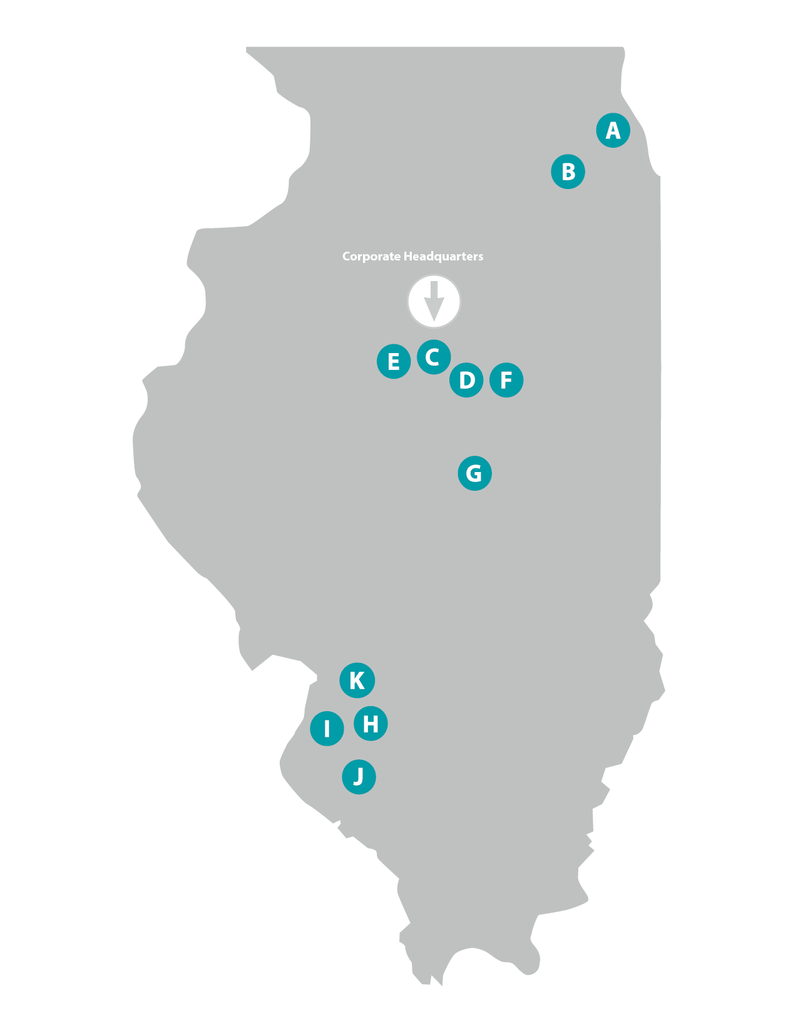
Locations
Chicago
Joliet
Bloomington – Corporate Headquarters
Bloomington – Current Health Center
Bloomington – Lighthouse Institute
Bloomington – Future Health Center
Decatur
Maryville
Granite City
Belleville
Edwardsville

Slide 29
SAMHSA Grant: Pregnant and Postpartum Women living with Opioid Use Disorder:
5 year grant being done in collaboration with Queen of Peace and the Wish Clinic at St. Mary’s Hospital in St. Louis.
1st Grant of its kind.
18 individuals per year will be served.
Services include:
Residential treatment & Recovery Home Services at Queen of Peace in St. Louis, Missouri.
Childcare options through Queen of Peace while receiving treatment services.
Medication Assisted Treatment through St. Mary’s Hospital.
Intensive Outpatient and Outpatient Treatment Through Chestnut.
Incentives for Treatment Compliance
Home based Parenting Education
Doula Services
Linkage to other supportive, wrap-around services

Slide 30
Closing and contact
Stephanie J. Schmitz Bechteler, Ph.D, Vice President and Executive Director Research & Policy Center at the Chicago Urban League sbechteler@thechicagourbanleague.org
Carie Bires, MSW Senior Policy Manager Illinois Policy Team, Ounce of Prevention Fund cbires@theounce.org
Julia Zhu, MPP Community Systems Policy Director Governor’s Office of Early Childhood Development julia.zhu@illinois.gov
Brent Cummins, MA, LPC, CADC, ATE, GCE Director of Adult Addiction Treatment and Recovery Support Chestnut Health Systems bcummins@chestnut.org

